Slide 1
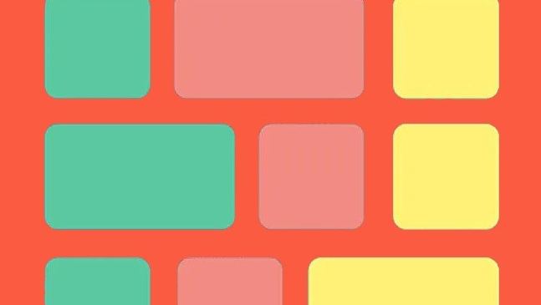
FLEXBOX
A Flexible Box Model

Slide 2
What is Flexbox?
Flexbox, was designed as a one-dimensional layout model, and as a method that could offer space distribution between items in an interface and powerful alignment capabilities.

Slide 3
Basics and Terminology - 01
main axis –primary axis along which flex items are laid out
main-start | main-end – flex items are placed within the container starting from main-start and going to main-end.
main size – flex item’s width or height, whichever is in the main dimension
cross axis – axis perpendicular to the main axis is called the cross axis
cross-start | cross-end – Flex lines are filled with items and placed into the container starting on the cross-start side of the flex container and going toward the cross-end side.
cross size – The width or height of a flex item, whichever is in the cross dimension

Slide 4
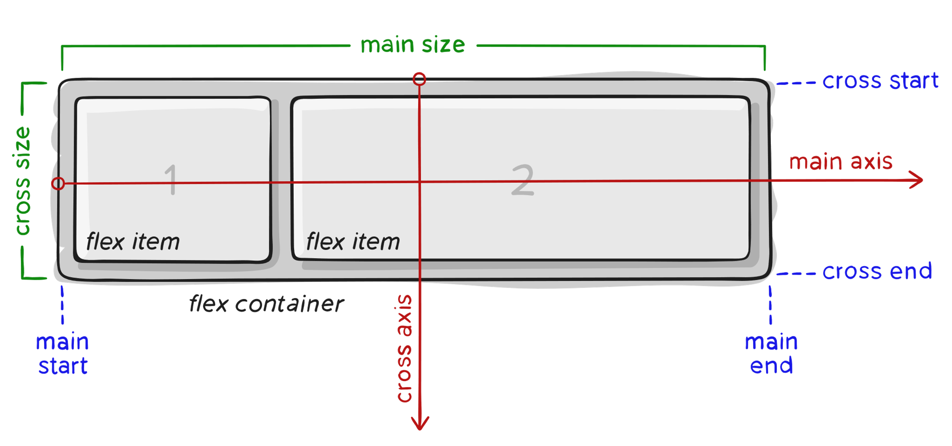
Basics and Terminology - 02

Slide 5
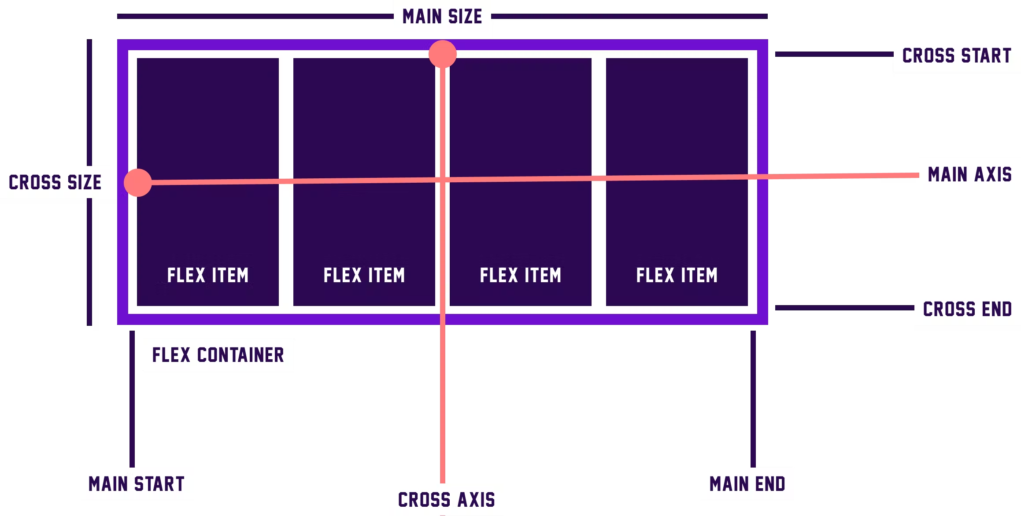
Basics and Terminology - 03

Slide 6
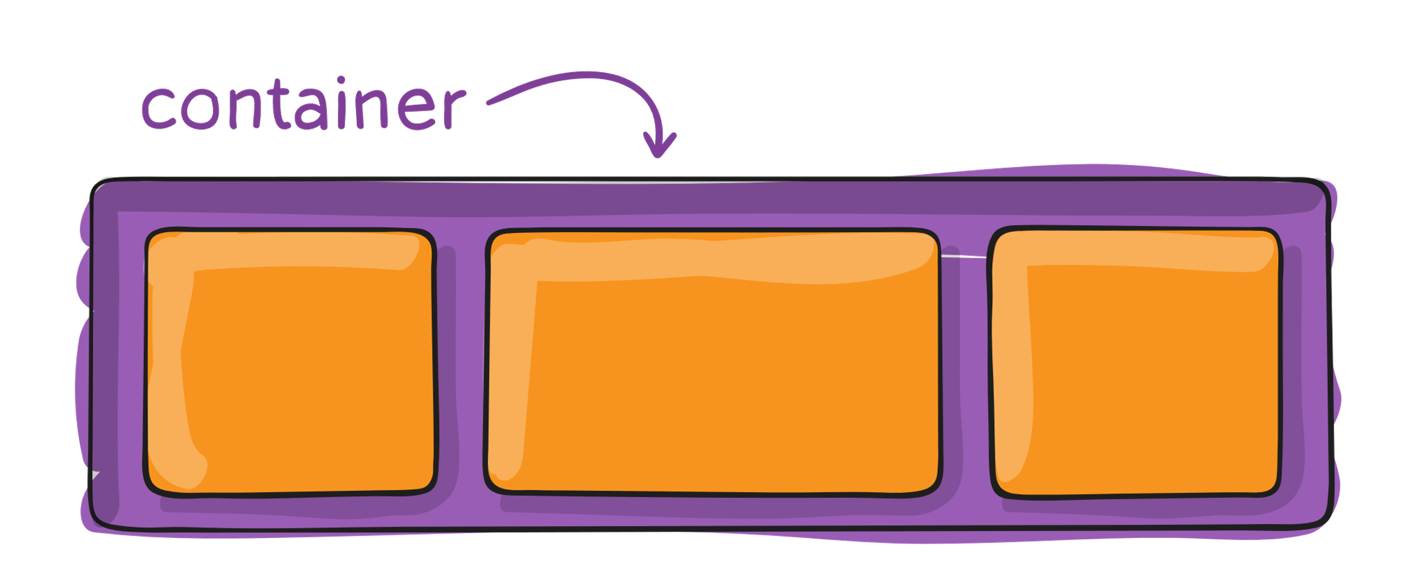
Properties of parent container
.container { display: flex; /* or inline-flex */ }
This defines a flex container; inline or block depending on the given value. It enables a flex context for all its direct children.

Slide 7
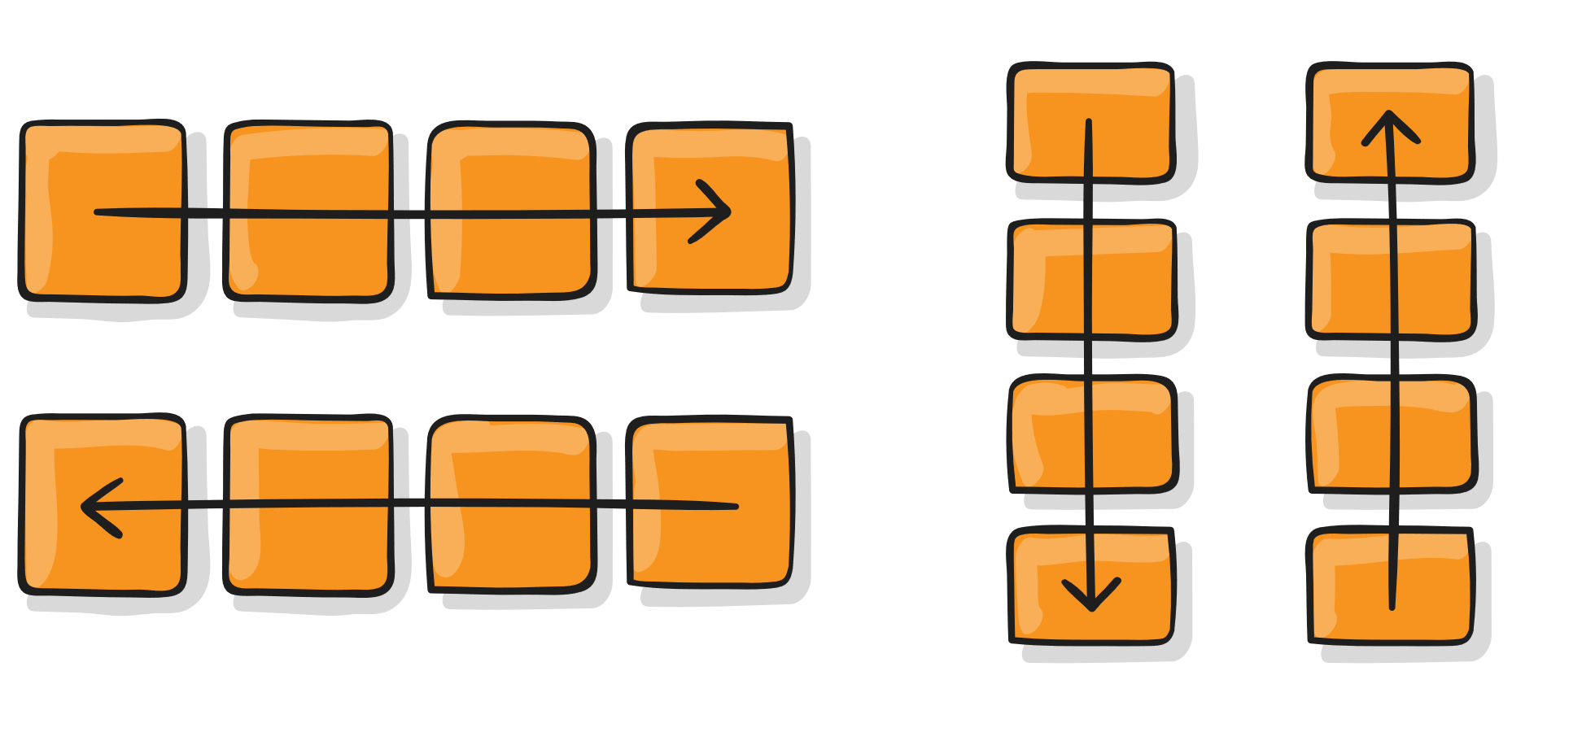
flex direction
.container { flex-direction: row | row-reverse | column | column-reverse; }
row(default) : left to right
row-reverse : right to left
column : top to bottom
column-reverse : bottom to top

Slide 8
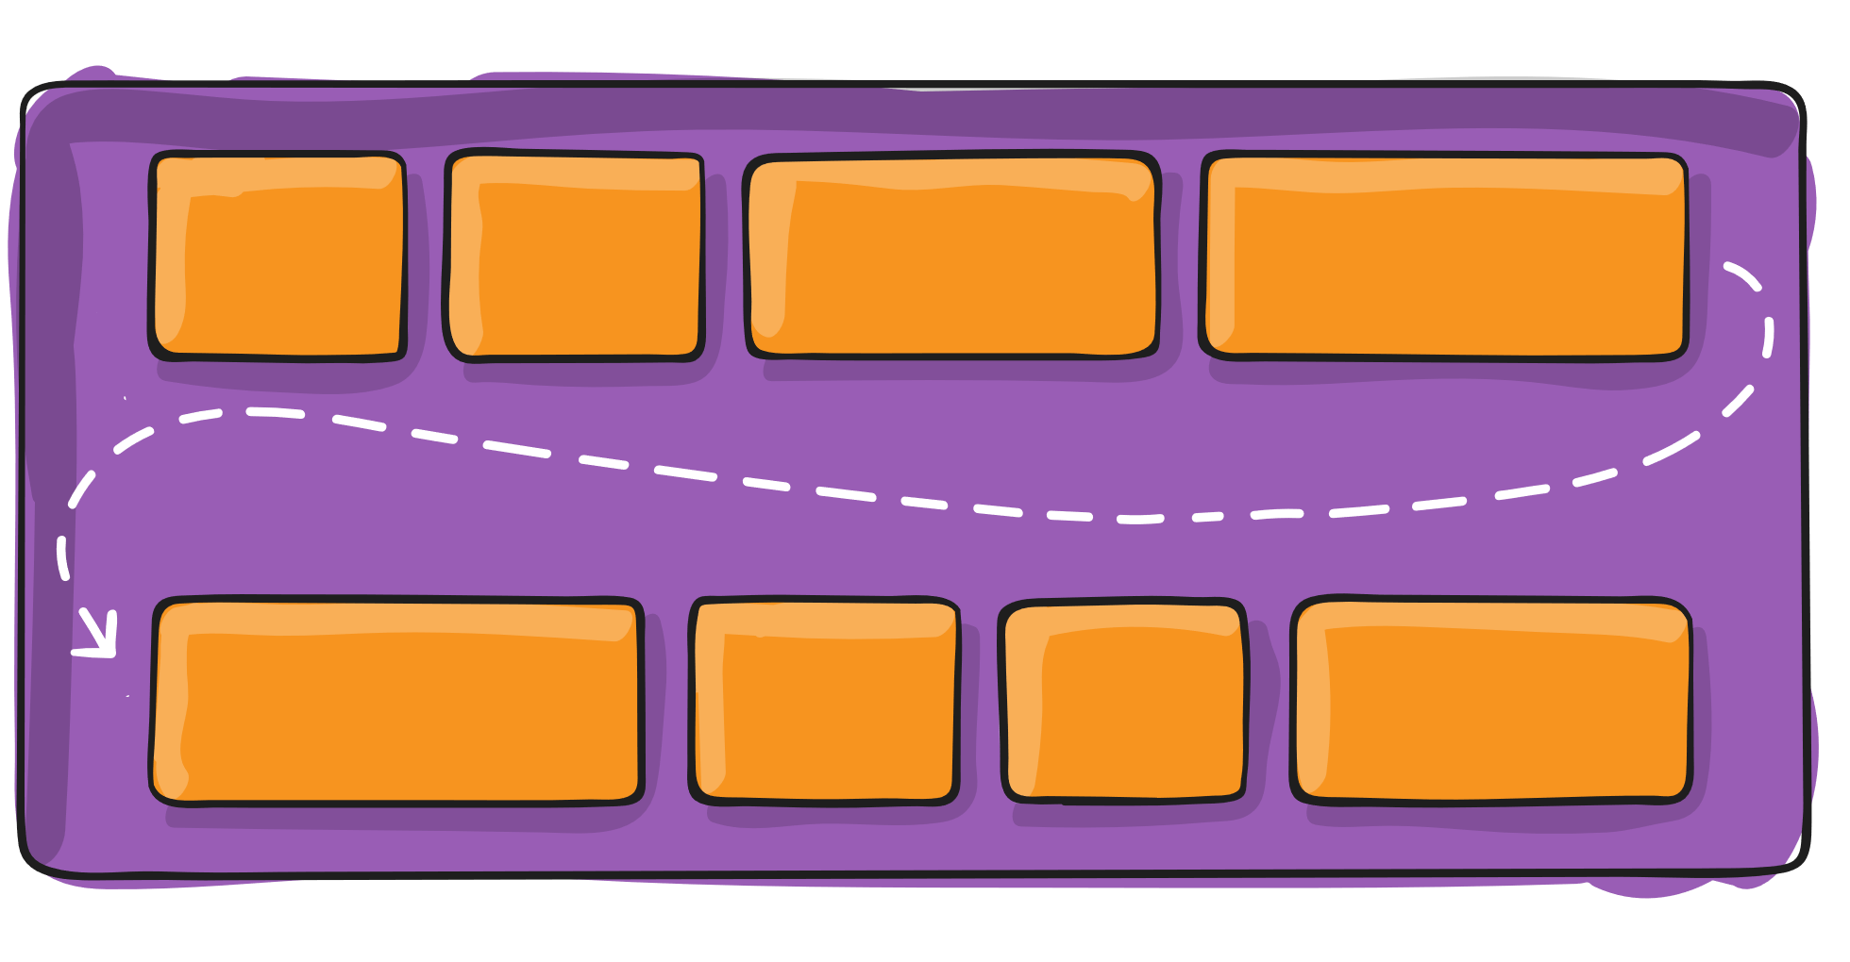
flex-wrap
.container { flex-wrap: nowrap | wrap | wrap-reverse; }
nowrap : all flex items will be on one line
wrap : flex items will wrap onto multiple lines, from top to bottom
wrap-reverse : flex items will wrap onto multiple lines from bottom to top.

Slide 9
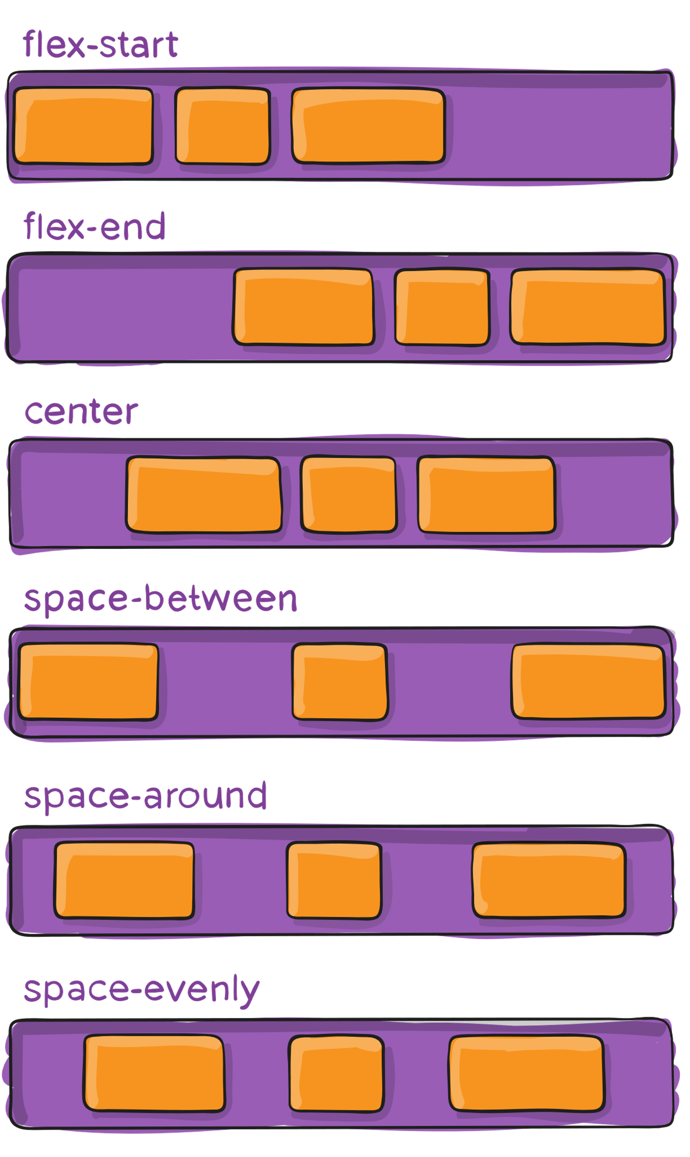
justify-content
.container { justify-content: flex-start | flex-end | center | space-between | space-around | space-evenly | start | end | left | right ... + safe | unsafe; }
It arrange content horizontally.

Slide 10
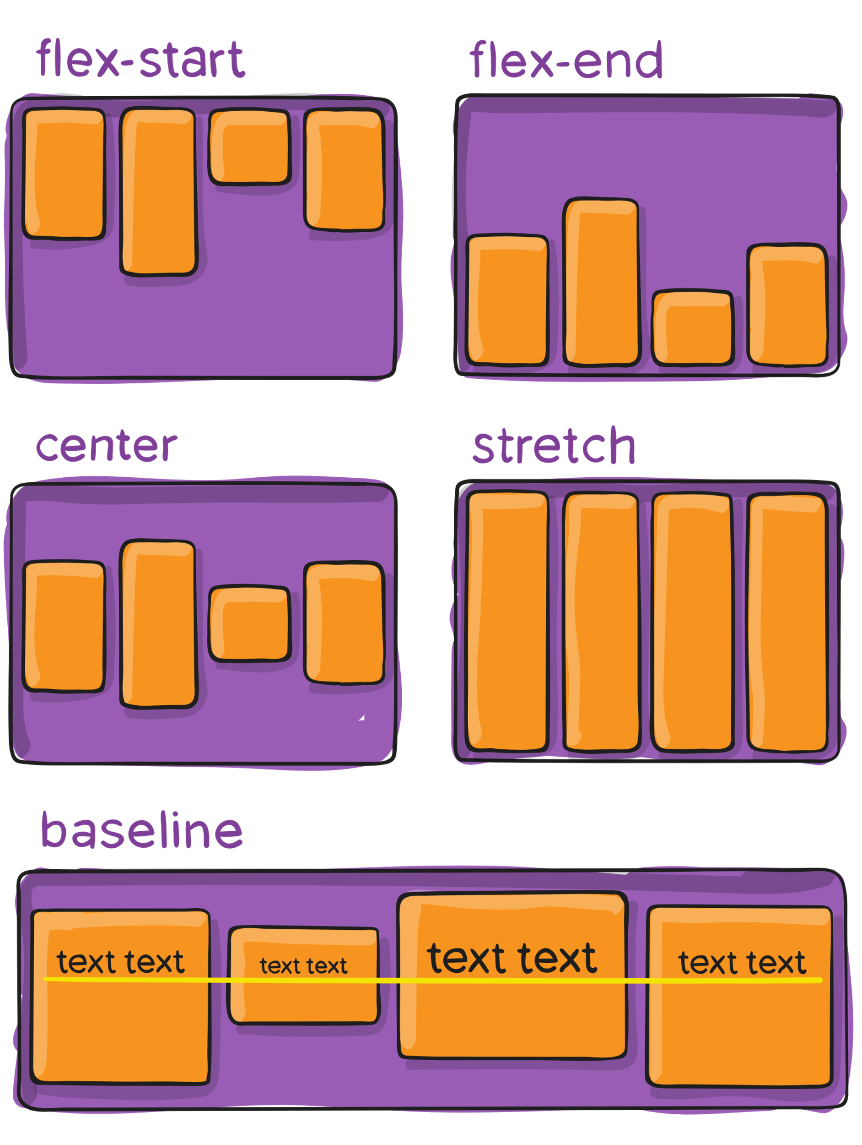
align-items
.container { align-items: stretch | flex-start | flex-end | center | baseline | first baseline | last baseline | start | end | self-start | self-end + ... safe | unsafe; }
It arrange content vertically.

Slide 11
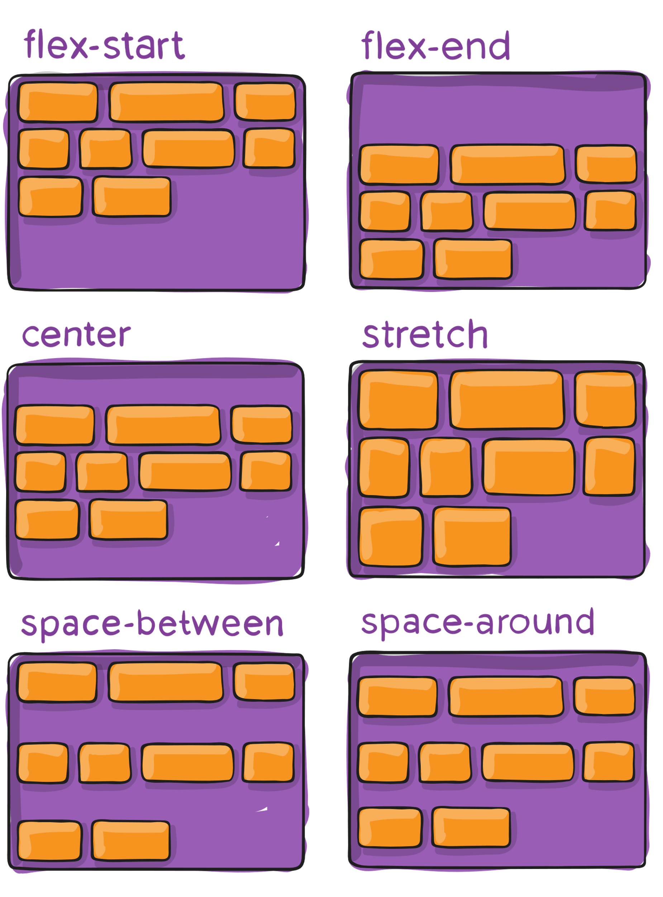
align-content
.container { align-content: flex-start | flex-end | center | space-between | space-around | space-evenly | stretch | start | end | baseline | first baseline | last baseline + ... safe | unsafe; }
This aligns a flex container’s lines within when there is extra space in the cross-axis, like how justify-content aligns individual items within the main-axis.

Slide 12
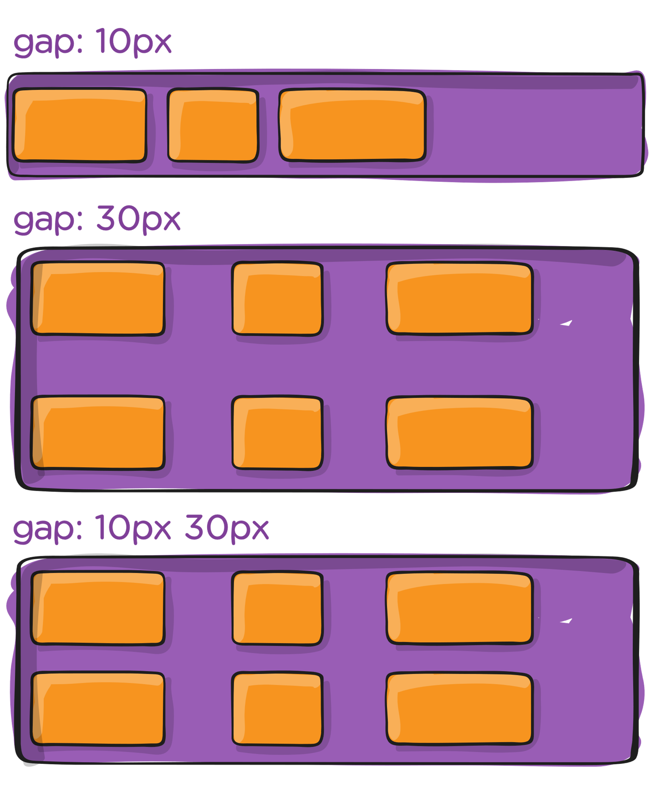
gap, row-gap, column-gap
.container {
display: flex;
...
gap: 10px;
gap: 10px 20px; /* row-gap column gap */
row-gap: 10px;
column-gap: 20px; }

Slide 13
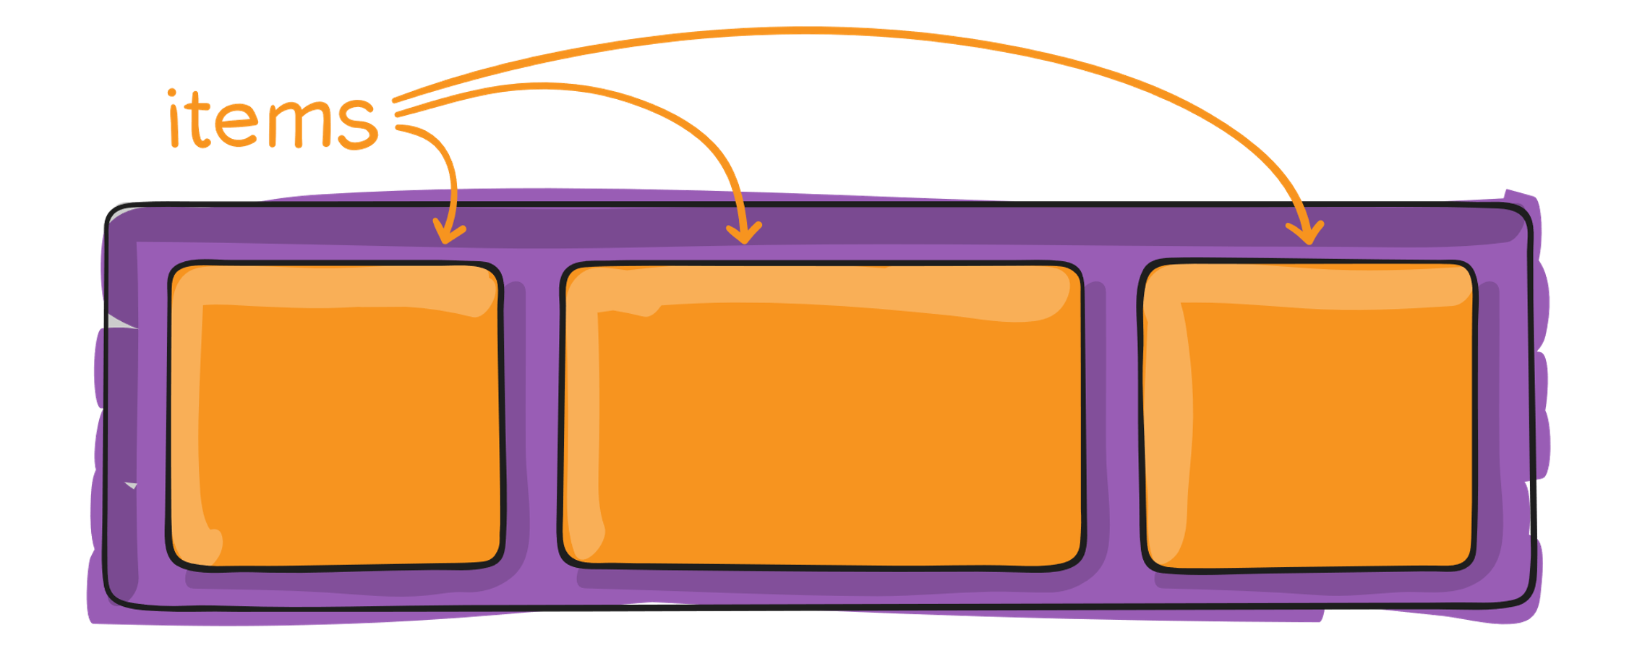
Properties of Child container

Slide 14
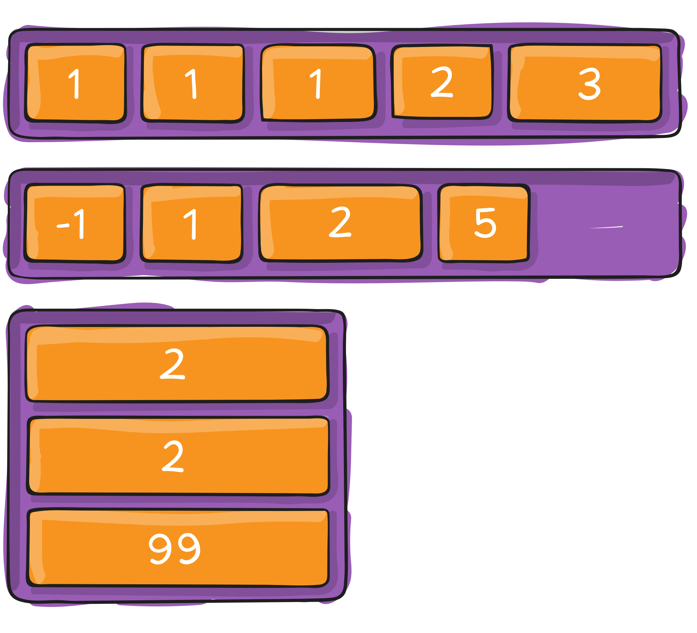
order
.item { order: 5; /* default is 0 */ }
By default, flex items are laid out in the source order.
Default order value is 0. Order value may be positive or negative. Smaller the order value early the placement of flex item.

Slide 15
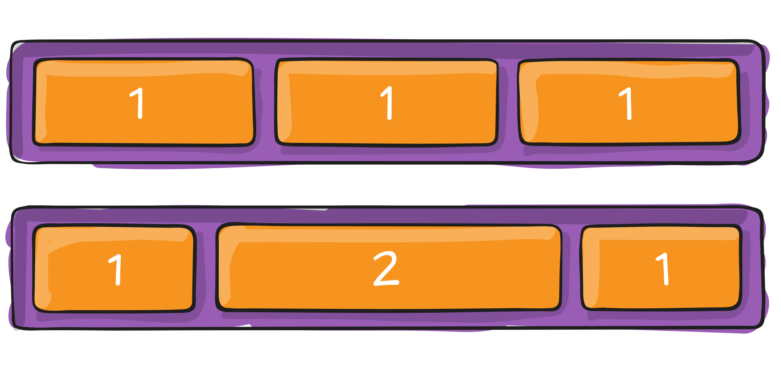
flex-grow
.item { flex-grow: 4; /* default 0 */ }
We specify how much space a flex item should cover.
This defines the ability for a flex item to grow if necessary.
It dictates what amount of the available space inside the flex container the item should take up.
Negative numbers are invalid.

Slide 16
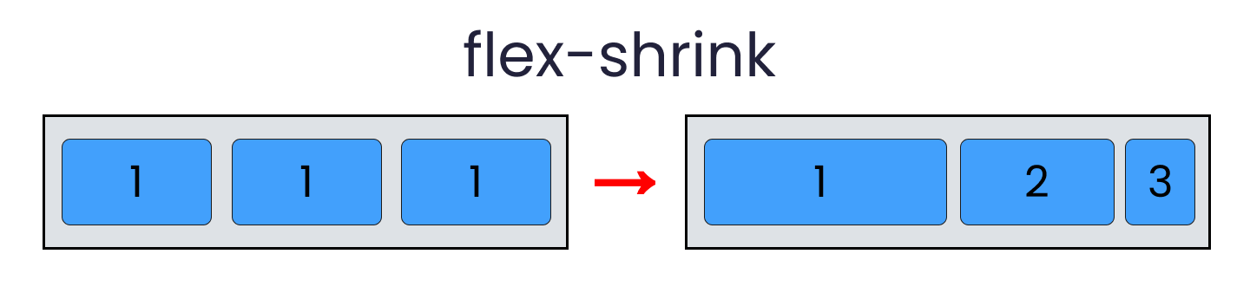
flex-shrink
.item { flex-shrink: 3; /* default 0 */ }
This property helps a flex item shrink based on the width of the flex-container. It's the opposite of flex-grow.
Negative numbers are invalid.

Slide 17
flex
.item { flex: none | [ <'flex-grow'> <'flex-shrink'>? || <'flex-basis'> ] } This is the shorthand for flex-grow, flex-shrink and flex-basis combined. The second and third parameters (flex-shrink and flex-basis) are optional. The default is 0 1 auto

Slide 18
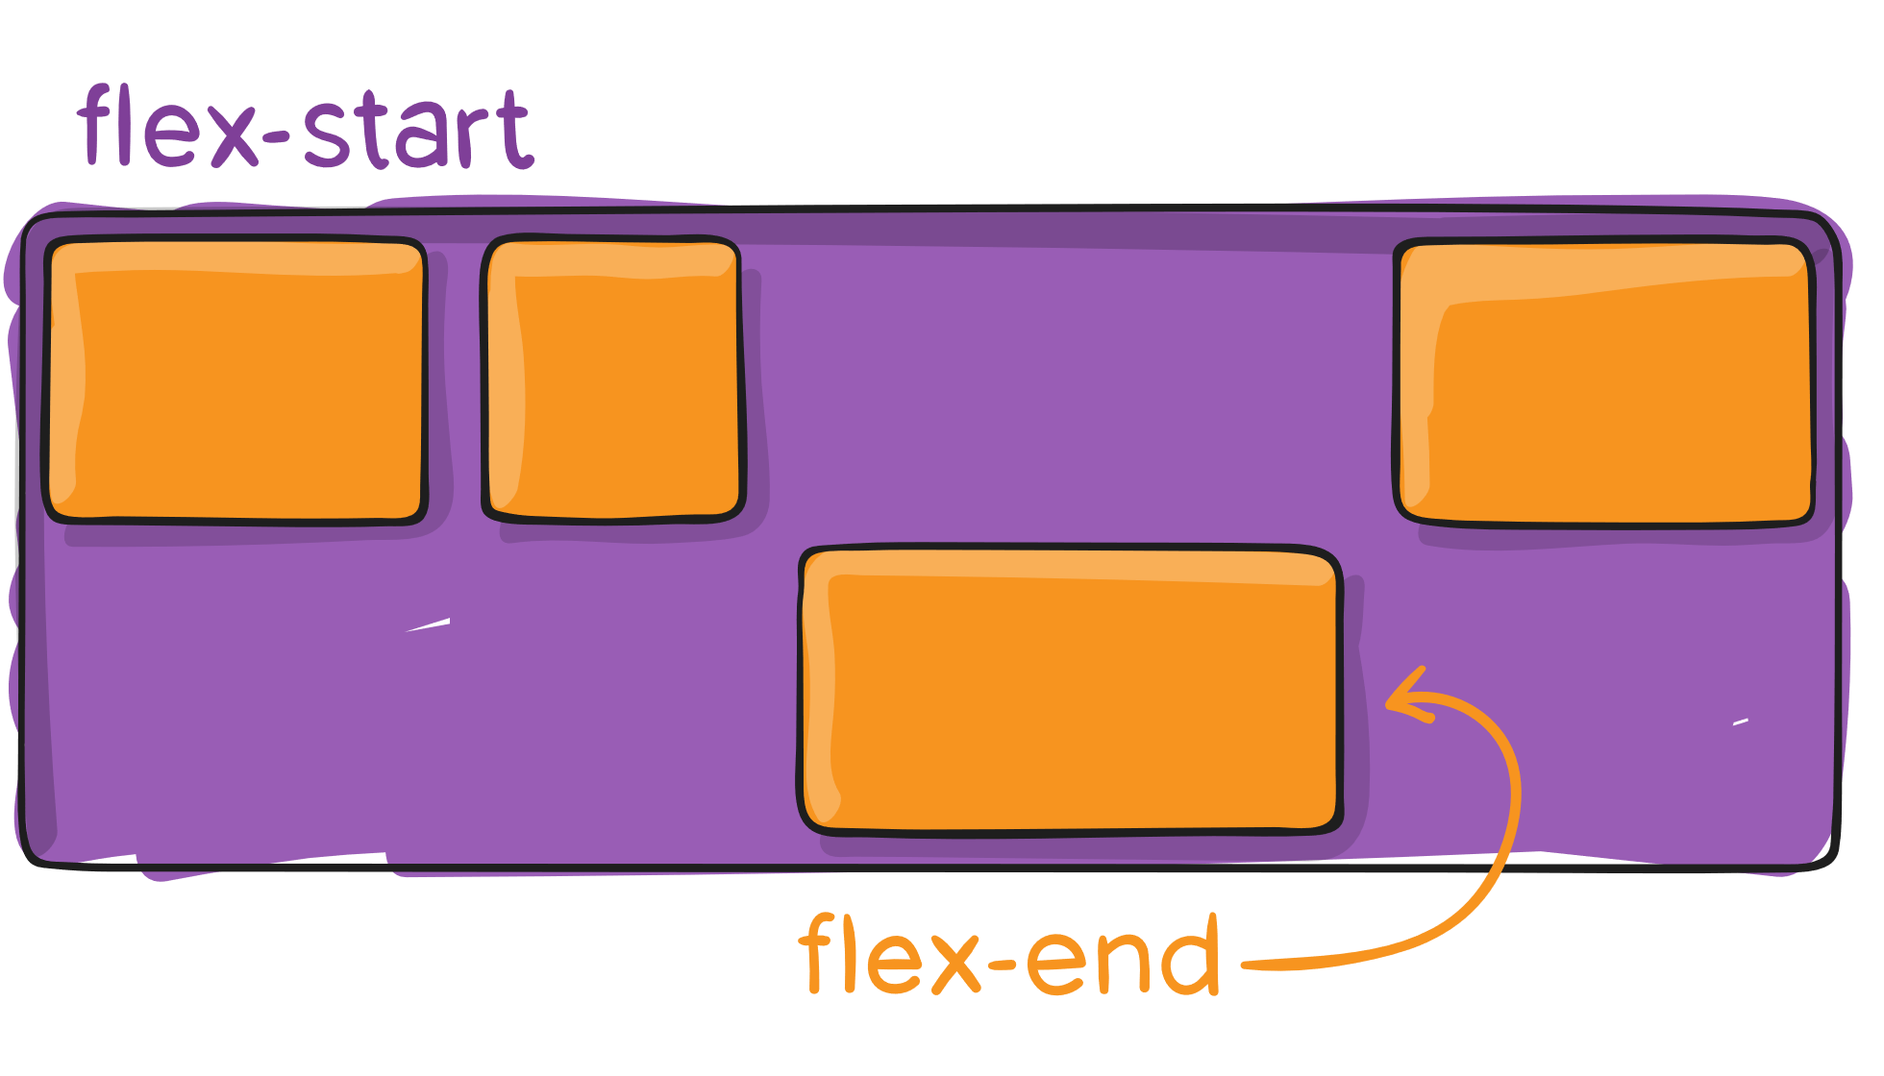
align-self
.item { align-self: auto | flex-start | flex-end | center | baseline | stretch; }
This allows the default alignment (or the one specified by align-items) to be overridden for individual flex items

Slide 19
Reference Links
freeCodeCamp FlexBox Guide
CSS Tricks FlexBox Guide
Press Ctrl + Click to access the links
MDN FlexBox Guide
Animated FlexBox Guide
Interactive FlexBox Guide

